Slide 1


GreensGo
Mock Presentation

Slide 2
Agenda
01
Quick run through
02
Sub System breakdown
03
Questions
04
Future possibilities

Slide 3
Infographic Style
Meet Our Team
Gene Marais
Eben Swart
“I think therefore I am”
“Wait it is December already,,,woah”
Hardware
Hardware
Gustaf Delport
Conradt v Heerden
Duran Govendar
“Thought constitutes the greatness of man”
“It is what it is”
“It is Wednesday my dudes”
Team Lead
Backend
API

Slide 4
Demo
Quick system breakdown

Slide 5
Sub System Breakdown
Hardware - Arduino
The Arduino is responsible for capturing data from the sensors inside the greenhouse
Hardware - Node
The Node is responsible for getting the data from the Arduino and sending it to the backend server.
Backend - Server
The backend server transmits the data from the Node in a readable format to the database. Handles hardware connections.
API – Connections
The API is the middleman between the database and the frontend.
Frontend - React
The frontend provides a visual representation of the data and gives the user a platform to interact with.

Slide 6

Hardware - Arduino
Why do we need this?
The Arduino is the “Brain” of our project we use it to capture the data and automate everything.

Slide 7
Hardware - Arduino
How the system works
#include <ArduinoJson.h>
• Handles the Json objects since Arduino lacks capability to do so.
#include <dht.h> (for dht library 11)
• Used for temperature and humidity sensor
• Send analogue data the sensor received
• Dynamically converts readings to percentages and Celsius degrees
#include <SoftwareSerial.h>
• Larger Arduino (this one), required to send data since it can access Internet
• Send serial data (which are 1’s and 0’s) to the node; communication
• Essentially all readings including temperature, humidity, moisture, light index etc.
dht DHT;
• Instance declared of dht
SoftwareSerial node(2, 3); //RX | TX
• Pin 2 and 3 will receive data
• RX for receiving, TX for transmission

Slide 8
Hardware - Arduino
How the system works
void setup()
• Implemented before anything further can take place; everything will be functional after start-up
Serial.begin(9600)
• Serial data start based on baud rate (rate at which information is transferred in a communication channel, bits
per second)
node.Begin(9600)
• Starts software serial port
pinMODE (RELAY_PIN, OUTPUT)
• Output is sent to pin 6 (the relay for water tap)
void loop()
StaticJsonBuffer<1000> jsonBuffer
• An instance of the Json library
• It is not dynamic and does not change
• 1000 bits of Json data can stored
JsonObject& data = jsonBuffer.createObject()
• JsonObject and data is whereby we created a JsonObject called data

Slide 9
Hardware - Arduino
How the system works
data.printTo(node)
• Sends the data to the node
data.printTo(Serial)
• Prints the serial data to computer
• Used for debugging purposes

Slide 10
Hardware - Arduino
How the system works
If else statement
• Where the applications needs to decide regarding the moisture levels and relay
• This is to determine when to turn the water pump on (if reading is HIGH) or off (if reading is LOW)
delay(5000)
• Allow application to wait in order to receive new readings

Slide 11
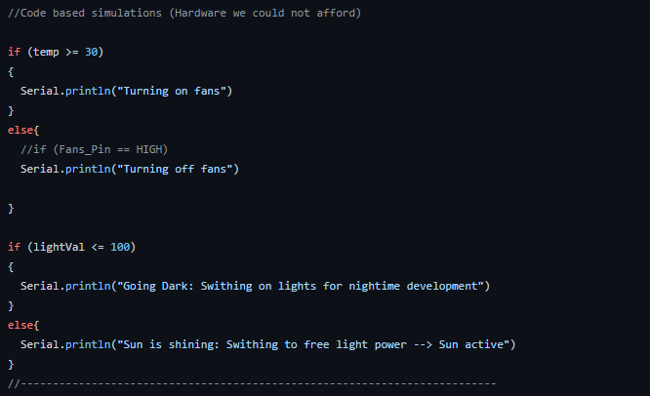
Hardware - Arduino
How the system works: Code simulations
If else statement
• Where the applications needs to decide regarding the temperature, light levels and fans, heat lights
• This is to determine when to turn the fans, lights on (if reading is HIGH) or off (if reading is LOW)

Slide 12
Hardware - Node
Why do we need this?
This device gives our Arduino they ability to connect to a network. Seeing as this product should be able to be monitored from the web, this is an important step in the process.

Slide 13
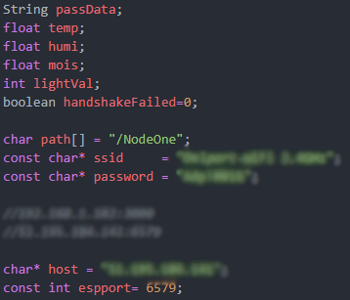
Hardware - Node
How the system works
Enter the SSID and Password of the router you are trying to connect to.
The “Host” is the IP address of the server we want to connect to.
The “espport” is the port number on the device at the “Host” IP address.

Slide 14
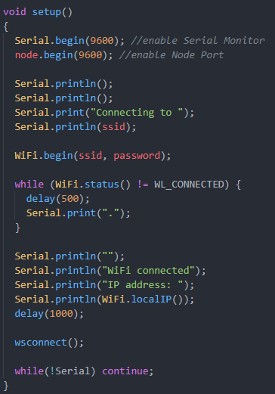
Hardware - Node
Quick explanation: connection to network
We enable the Node and the Serial Monitor
“Wifi.Begin”: This attempts to connect the node to the network with the SSID and password provided. The program will only continue once it is connected.

Slide 15
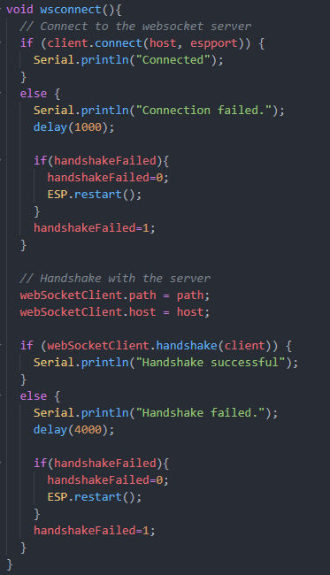
Hardware - Node
Quick explanation: connection to server
It attempts to connect to the IP that was set earlier.
If it fails, it restarts the ESP and tries again.
When it succeeds, it attempts to make a handshake with the server.
If it fails, it restarts the ESP and tries again.

Slide 16
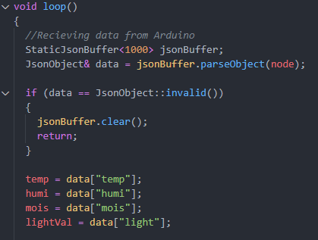
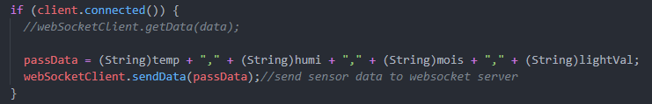
Hardware - Node
Quick explanation: Receiving Data
This receives data from the Arduino.
If the JSON object is not valid, it sends the data to the server.

Slide 17
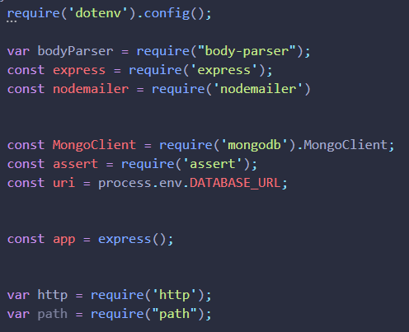
Backend - Server
Basic Back-end
Here is where the basic creation every express server happens.
All the modules are required and grouped here to keep the code clean.
-Nodemailer module is used to send emails. -Assert module is used to when values are returned such as 0 or false, the program does not automatically terminate.
-Http is a zero-configuration module

Slide 18
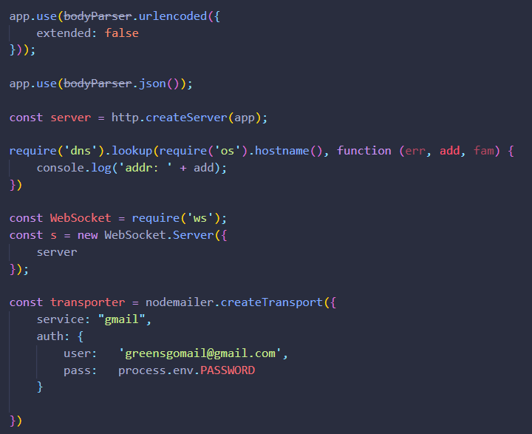
Backend - Server
Basic Back-end
We then create the server by assigning it to const server.
A private dns is then created in order to privately authenticate the server and node modules.
After that we use the WebSocket module, to create a new socket.
Lastly, we use nodemailer to authenticate and setup from who the email is coming from.

Slide 19
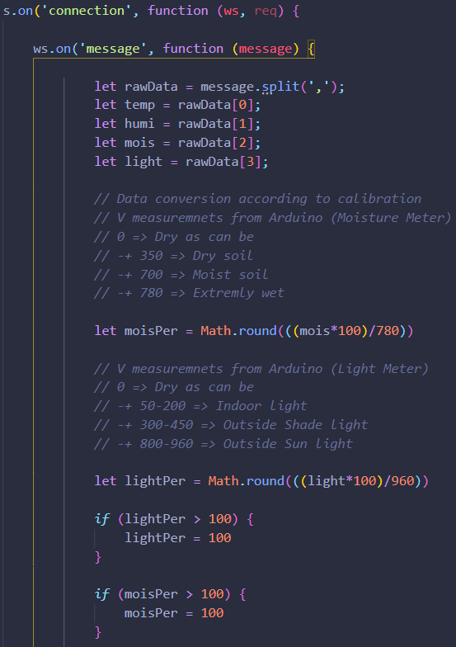
Backend - Server
Basic Back-end
When we receive a connection, the following will happen.
If we receive a message from client trigger function, we take that message and split it up into the data parts that we need. These include the temperature, humidity, moisture level and light index.
We then calculate the moisture and light percentage from the reading that was done with the Arduino and its sensors.
If the percentages are too high, we set them to a fixed 100 so we can use them to determine what action need to happen.

Slide 20
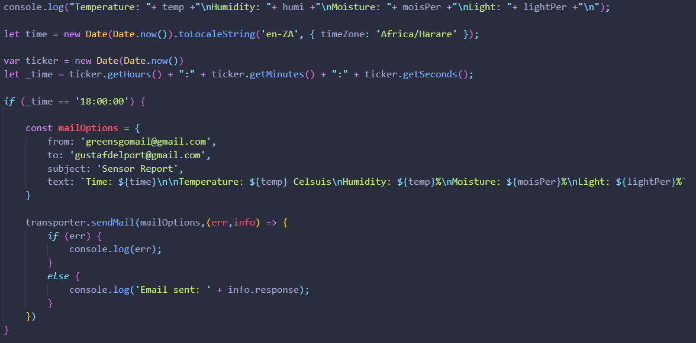
Backend - Server
Basic Back-end
For testing purposes, we log the data to see if there are any errors.
Since the server is in Canada, we need to set the location, otherwise when we want to receive an email at a specific time we won't get it, as we will receive it at the specified time in Canada.
We get the current Date to determine when the email should be sent.
If it is 6pm an email is created and sent.
We can use an array of emails where the “to” is specified to send emails to multiple people.
Finally, the email is sent. There is error handling as well.

Slide 21
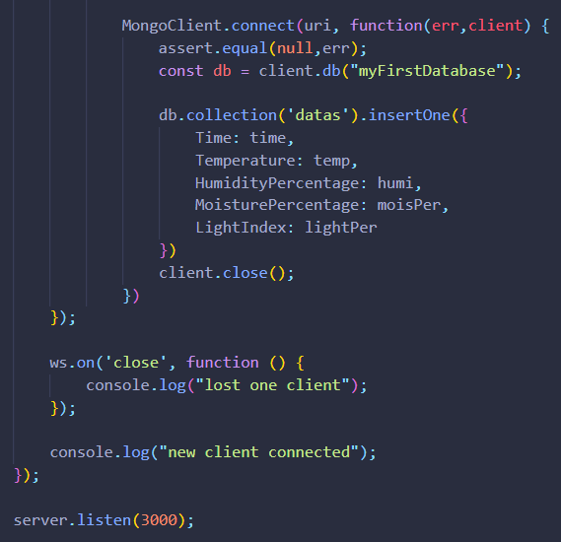
Backend - Server
Basic Back-end
We connect to MongoDB and check if there is a Database. If not, we make one and store the values in a collection. Note that we only insert 1 and not multiple. This inserting happens every 30 mins.
The data that is inserted is in JSON format, and we insert every piece of data that we captured.
When a client then disconnect, we log a message.
The server runs on port 3000.

Slide 22
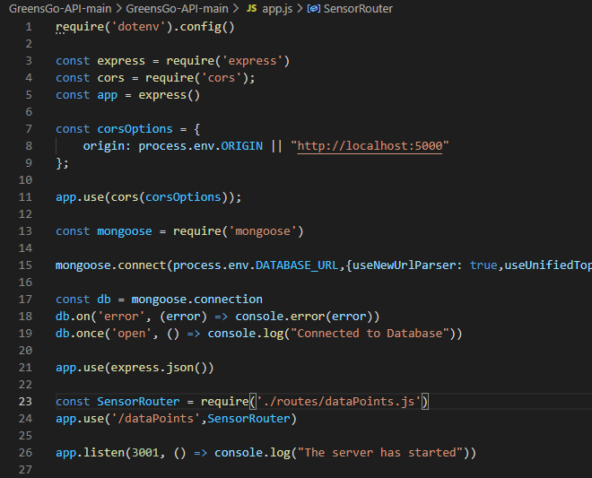
API - Connections
Basic API
Uses Http requests to access and use data. app.js is the connection to database(mongoDB).
The purpose of the API is to create a connection for communication so that the front end and back end can send and receive information from one another.
const cors = require(‘express’) is a security feature that ensures that no IP address unless defined has access to the API.

Slide 23
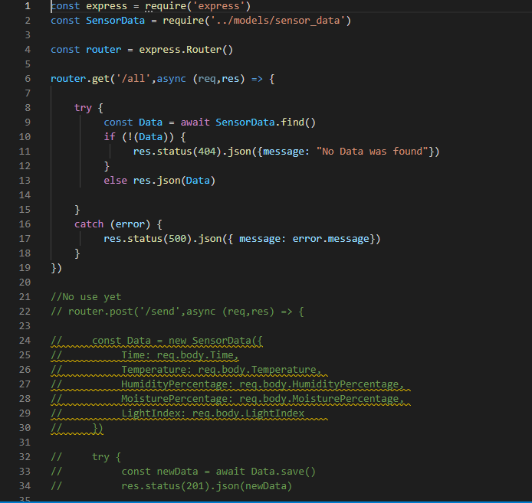
API - Connections
API : How it works
This part of the application gathers all the data from what the sensor pulled from the Arduino and shows it on the front end in a format. The data that it pulls is the time, temperature, humidity, moisture and light variation.
The sensor data is stored in the database, once the API connection between the database and itself is running we can access the data of the sensor in real time and view it in the web application.

Slide 24
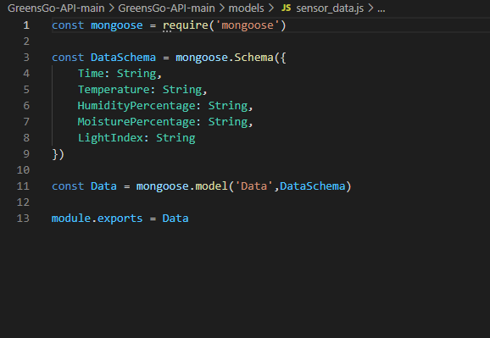
API - Connections
API : System responsibility
Overall responsibility of our API is to observe the data from the device we installed as soon in the DataSchema.
Some of the dependencies used in the creation of the API are:
Nodemon: works mainly as a time saver so we don’t have to restart the application every time we make changes.
dotenv: allows us to keep certain areas private(security measure)
Express: allows us more functionality when creating the API
Mongoose: manages the relationship between data, provides schema validation and is needed for mongoDB.

Slide 25
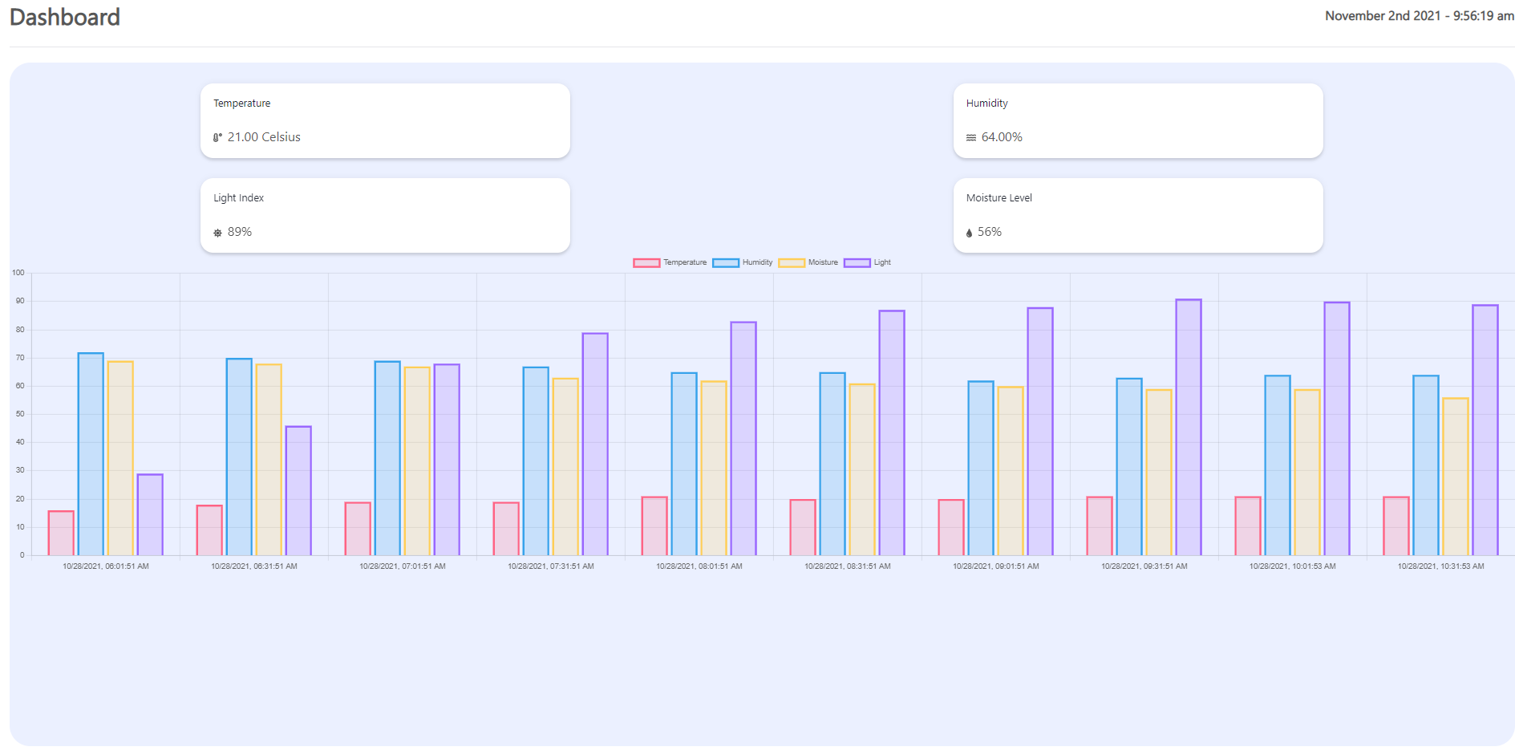
Frontend - React
Frontend – React
The Frontend is mainly responsible for showing an interactive connection to users

Slide 26
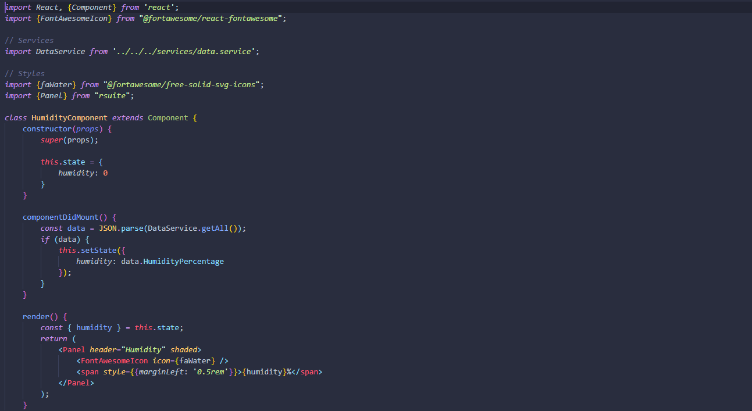
Frontend - React
Build using React
The Frontend was created using React, React is a component-based framework that is easy to use and easier manage.

Slide 27
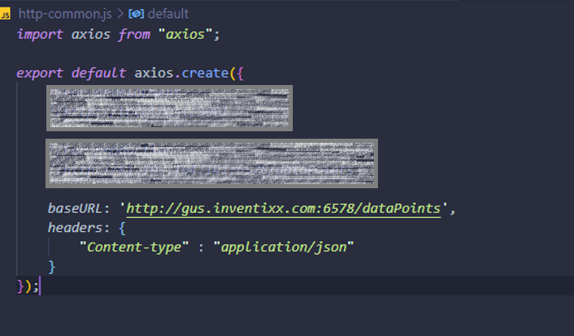
Frontend - React
Connected using Axios
The frontend is connected to the API using Axios: Axios is super easy and powerful connection library.

Slide 28
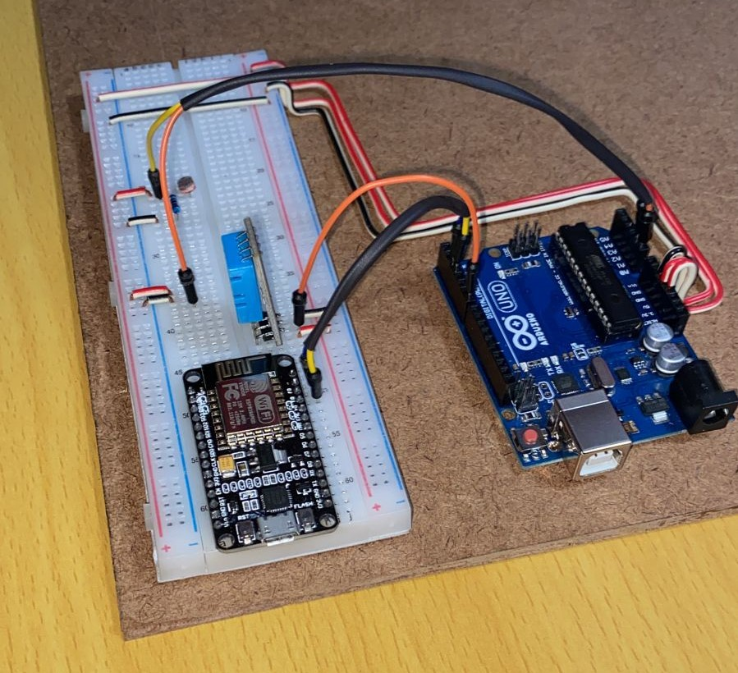
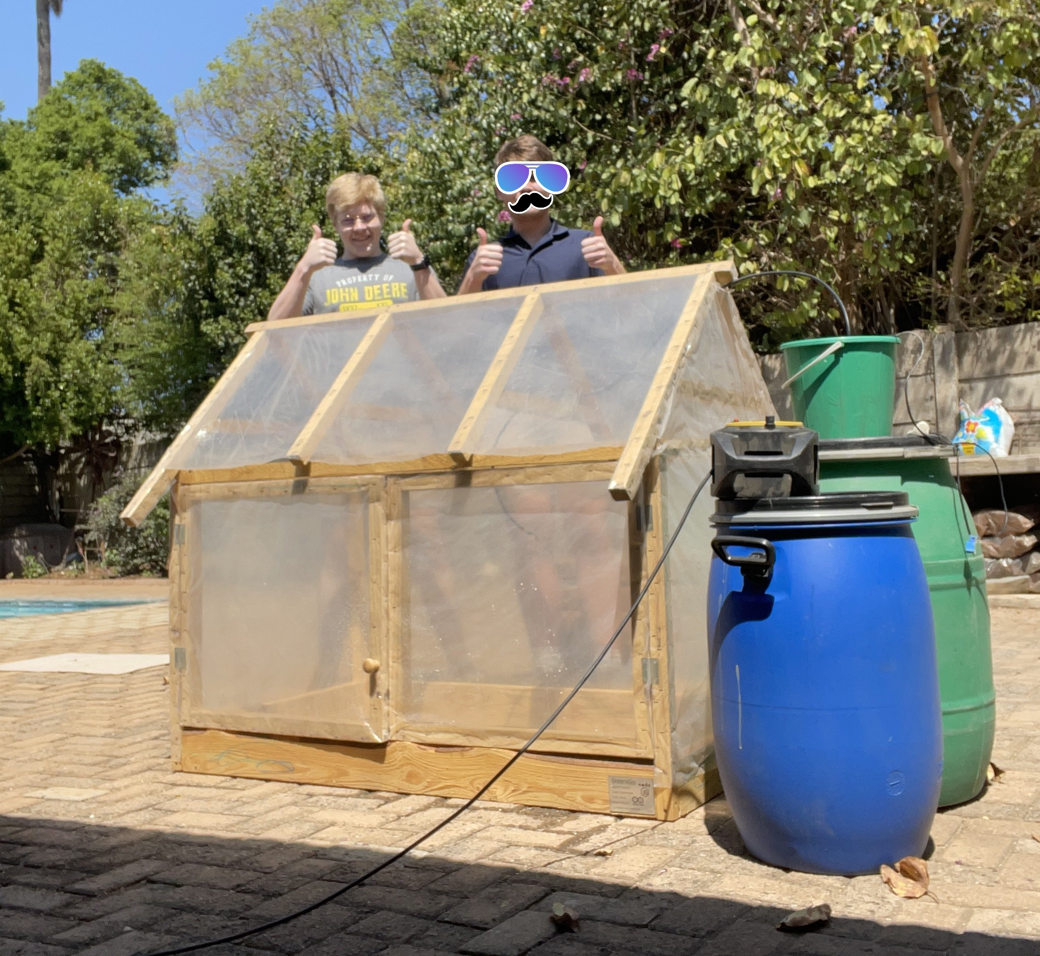
The Hardware

Slide 29
Questions
Ask away!

Slide 30
Future possibilities
An improved Cooling system
Currently using natural air flow. A fan and a louver system can improve ventilation
Ideas
Data Capture
Potential Investors
From the live feed we receive about the conditions and growth of items within the greenhouse we can expand further or make improvements within the project.
Expand knowledge
Grow Market
Our plan and idea of GreensGo can be sold or invested into companies that are focused on environmentally friendly projects
Innovate
Create opportunities
Make smaller, more modern
GreensGo expansion
We are going to admit our design is not the sleekest we would really like to make the device more appealing to the eye.
In the future the system and size of the greenhouse project can grow into a bigger environment and will therefore need more than one or two people monitoring the site, this will allow room for employees to help maintain and develop the project further

